Slide 1
Malnutrition in under-five child deaths:
Missed diagnoses in Sierra Leone, 2019-2022
Erick Kaluma
November 30, 2022

Slide 2
Outline
Burden, effects and trends in child malnutrition
CHAMPS
Malnutrition in under-5s in the CHAMPS study
Discussion

Slide 3
Malnutrition
Malnutrition is defined as deficiencies or excesses in nutrient intake, imbalance of essential nutrients or impaired nutrient utilization
Malnutrition is a highlighted by SDG target 2.2
50% of under five deaths have malnutrition in the causal chain

Slide 4
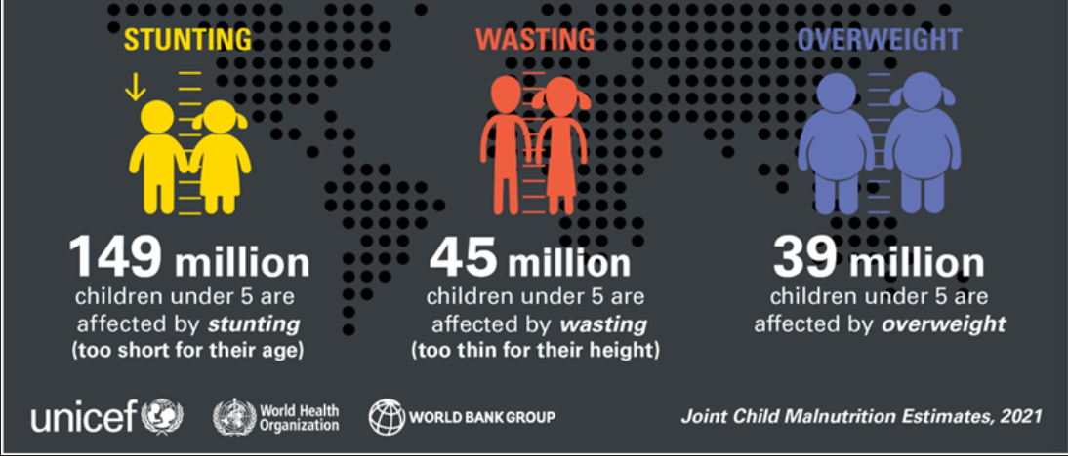
The global burden of Malnutrition- (n= 233 Million)

Slide 5
Global percentage of <5’s with stunting
Source: UNICEF/WHO/WB Joint Child Malnutrition Estimates

Slide 6
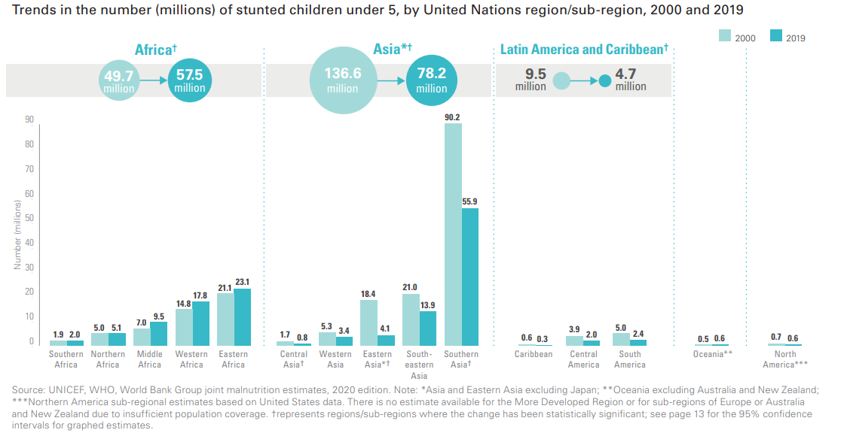
Trends of malnutrition

Slide 7

Malnutrition in <5 in Sierra Leone
63,362 (1.4%) children are severely malnourished
33% of <5 are stunted
176,269 (3.9%) have acute malnutrition annually

Slide 8

Effects of malnutrition
Weakened immunity
Susceptible to long-term developmental delays
Severe irreversible physical and cognitive damage

Slide 9
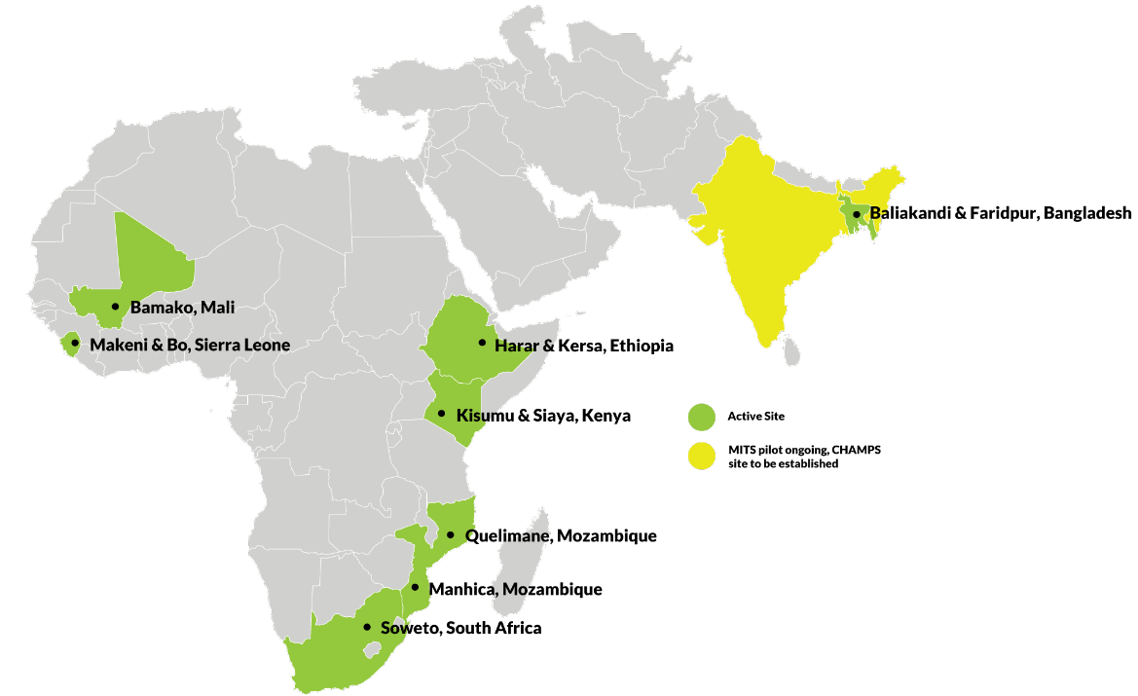
CHAMPS
Child Health And Mortality Prevention Surveillance
Global surveillance network that generates and shares accurate cause of death data on child mortality
Uses innovative approaches
Baliakandi & Faridpur,Bangladesh

Slide 10
CHAMPS methods
Demographic Data
DeCoDe Panel of experts
Cause of Death Assignment
(ICD-10 and ICD-PM) and PH recommendations
Verbal Autopsy
Clinical Abstraction
Available medical records
Maternal Abstraction
MITS Collection Data
Anthropometrics
Photographs
Molecular Diagnostics
TAC Results
Other Diagnostics
Blood and CSF culture
HIV (PCR)
TB (GeneXpert)
Malaria blood smears and RDT
Pathology Results
Site pathology report
CDC Central Pathology Laboratory: special stains, immunohistochemistry
Whole slide images

Slide 11
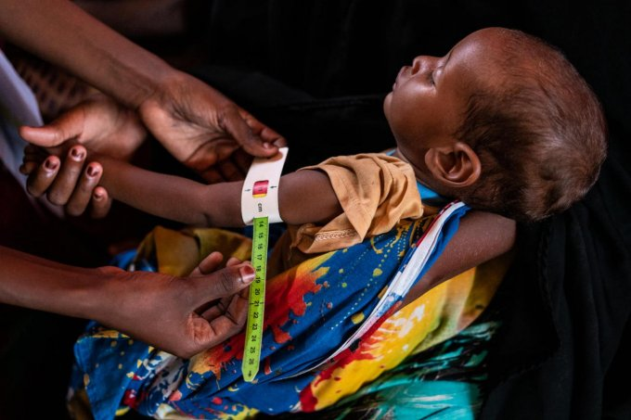
Methods
Study period: 2019 to 2022
Inclusion
  Children 6 months to 5 years
  Clinical abstraction data is available
  Malnutrition in the causal chain of death
Exclusion
  Cases without clinical abstraction
Objective
  To compare the accuracy of diagnosis of malnutrition between clinicians and the CHAMPS DeCoDe panel

Slide 12
WHO criteria for diagnosing undernutrition
Diagnoses of malnutrition | Reference
Mid-upper arm Circumference (MUAC) | <MUAC 125 mm
Z-Scores | Z-Score <− 2 SD of the median
Clinical signs | Weight loss, muscle loss, fat loss, fluid accumulation, diminished grip strength etc.

Slide 13
Proportion of cases with missed diagnosis (n = 159)

Slide 14
Clinical management of cases (35%)
Ante-natal care (15%)
Health-seeking behaviour (21%)
Accurate and appropriate health education (20%)
Access to HIV-prevention services (1%)
Nutritional support (6%)
Infection prevention and control practices (7%)
DeCoDe panel recommendations for public health improvements
(All CHAMPS cases)

Slide 15
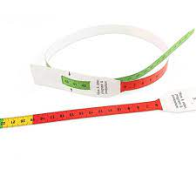
Discussion and Recommendations
  Clinicians are missing a diagnosis of malnutrition in up to 76% of children <5
  Improving of the capacity for the clinical diagnosis of malnutrition
  Additional qualitative research is needed

Slide 16






Acknowledgements
Catchment stakeholders
Families,
Communities
Makeni Regional Hospital
Peripheral Health Units
Co-authors
D. Kowuor,
B.M. Duduyemi
I.U. Ogbuanu
Donor and technical office
Bill and Melinda Gates Foundation
Emory University

Slide 17
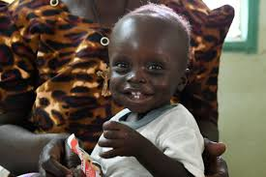
Ténki.
www.champshealth.org

